Slide 1
Wellness Programs & Quality Projects

Slide 2


Take Charge! Wellness Programs brochure (mnscha.org)
TakeCharge for SeniorCare Complete and AbilityCare (mnscha.org)

Slide 3

Wellness Programs – South Country Health Alliance (mnscha.org)
Be Active™ Exercise Reward Program
Be Rewarded™ Preventive and Well-Care Rewards
Community Education and Early Childhood Family Education - Class Discounts
Embracing Life Online – South Country Health Alliance (mnscha.org) online content for pregnant women
Be Buckled™ Free Car Seat Program
Wellness Checklist 5951.pdf (mnscha.org)
South Country Health Alliance Member Services
1-866-567-7242  TTY 1-800-627-3529 or 711

Slide 4
Be Active™ Exercise Reward Program
South Country offers the Be Active™ program that rewards members for exercising. South Country AbilityCare, SingleCare, SharedCare, MSC+, and SeniorCare Complete members will be eligible for up to $20 off the cost of their monthly health club membership fees.

Slide 5
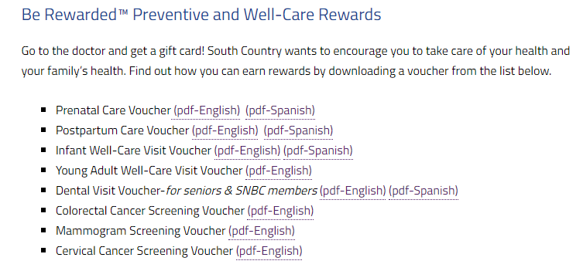
Be Rewarded™ Preventive and Well-Care Rewards Wellness Programs – South Country Health Alliance (mnscha.org)

Slide 6
Community Education Discounts
Community Education offers classes for both children and adults. Brush up on special skills or learn a new hobby. South country will cover up to $15 of the registration fee for most Community Education classes (up to 5 per calendar year). Call your local Community Education office or Member Services for more information.

Slide 7
Embracing Life Online
Embracing Life is a calendar guide and companion website pages for new and expecting mothers. They have helpful information about prenatal care and care for newborns during their first year of life. The printed guide includes a pregnancy calendar for you to follow from week to week. Call Member Services to ask for a copy or download it from the Embracing Life Online pages.

Slide 8
Be Buckled™ Free Car Seat Program
South Country will provide one car seat per child age 7 and younger, per lifetime, along with training on how to safely use the car seat. Call your local county public health office to learn more about this program and to schedule a time to receive your child’s car seat and training.

Slide 9
Population Health and Quality Projects

Slide 10
Population Health Management
South Country Health Alliance’s Population Health Management (PHM) strategy is a collaboration of departments, community partners, and counties, that includes services and programs to maintain and improve health care quality and outcomes.

Slide 11
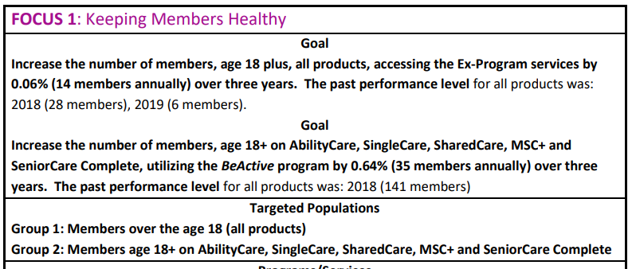
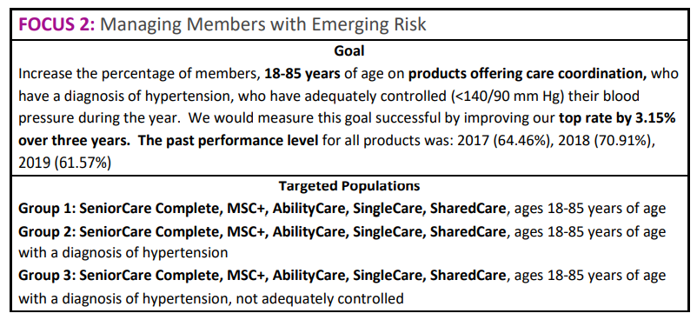
Population Health - Focus 1 & 2

Slide 12
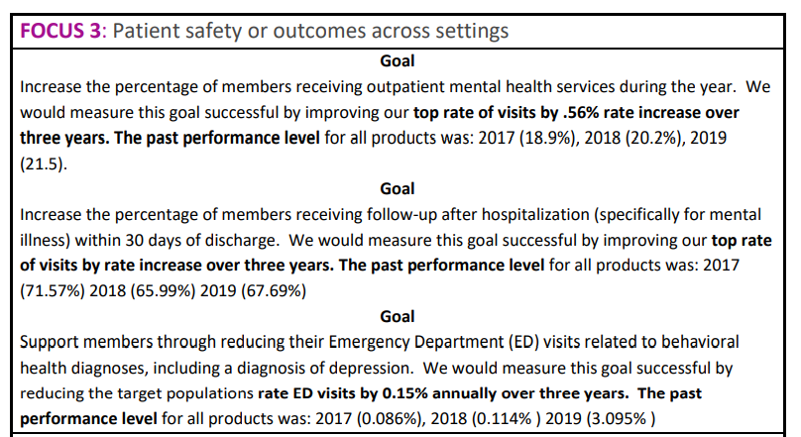
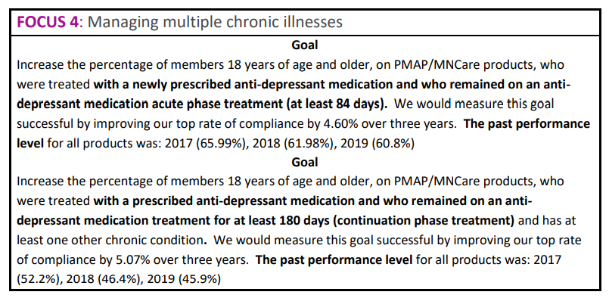
Population Health – Focus 3 & 4

Slide 13
Diabetes Performance Improvement Project
Comprehensive Diabetic Care - for members enrolled in AbiltyCare,SingleCare,SharedCare,MSC+ and SeniorCareComplete). This performance improvement project has a focus on health disparities and is in place for calendar years 2021 – 2023. Our goal is to improve members self-management of their diabetes for those living in rural communities and experiencing geographic health disparities

Slide 14

Diabetes Care Certificate (Diabetes Dx Type 1 or Type 2 Diabetes)

Slide 15

Hy-Vee Collaborative Virtual Store Tour – South Country Health Alliance (mnscha.org)

Slide 16
Healthy Start for Mothers and Children Performance Improvement Project
The project is intended to promote a “Healthy Start” for the health of our mothers and children ages (0-15 months) on our PMAP and Minnesota Care programs experiencing the effects of geographic disparities due to living in rural communities.
Voucher Rewards
Embracing Life and Baby First Year Calendar
Pregnancy Lists

Slide 17
Colorectal and Breast Cancer - Chronic Care Improvement Project
the target population Members enrolled in SeniorCareComplete and AbilityCare who do not have an up-to-date colon cancer screening (Ages 45-75) and members who do not have an up-to-date breast cancer screening (Ages 50-74).
American Cancer Society Collaboration
Informational and educational materials
Voucher Rewards
Mailings

Slide 18
Cervical Cancer Screening – Focused Study
increase the overall percentage of PMAP, MinnesotaCare, SingleCare, SharedCare, and AbilityCare members ages 21-64 who receive a cervical cancer screening
Education
Facebook
Reward Incentive
Member Mailings
American Cancer Society Collaboration

Slide 19
Chlamydia Screening Focused Study
The primary goal of this focus study is to increase the overall percentage of MinnesotaCare, PMAP, SingleCare and Shared Care members ages 16 - 24 who were identified as sexually active and who had at least one test for chlamydia
Wellness Reward Incentive
Outreach to members and Education

Slide 20



Questions?

